Slide 1
Last time: Logic and Reasoning
Knowledge Base (KB): contains a set of sentences expressed using a knowledge representation language
  TELL: operator to add a sentence to the KB
  ASK: to query the KB
Logics are KRLs where conclusions can be drawn
  Syntax
  Semantics
Entailment: KB |= a iff a is true in all worlds where KB is true
Inference: KB |–_{i} a = sentence a can be derived from KB using procedure i
  Sound: whenever KB |–_{i} a then KB |= a is true
  Complete: whenever KB |= a then KB |–_{i} a

Slide 2
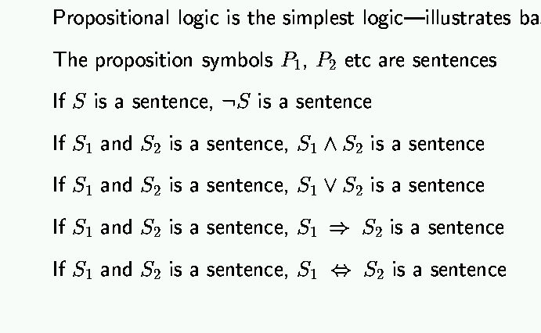
Last Time: Syntax of propositional logic

Slide 3
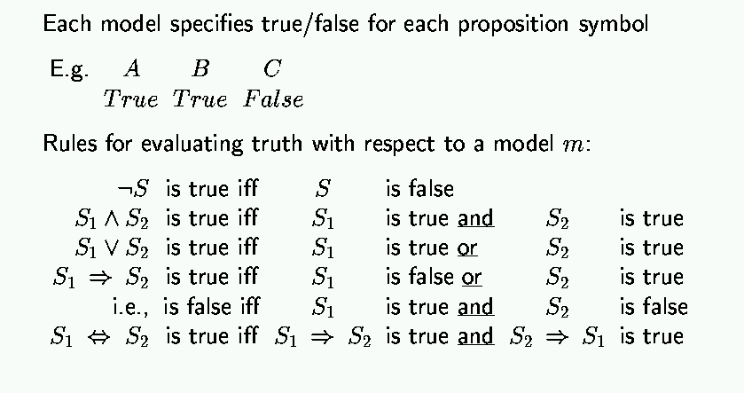
Last Time: Semantics of Propositional logic

Slide 4
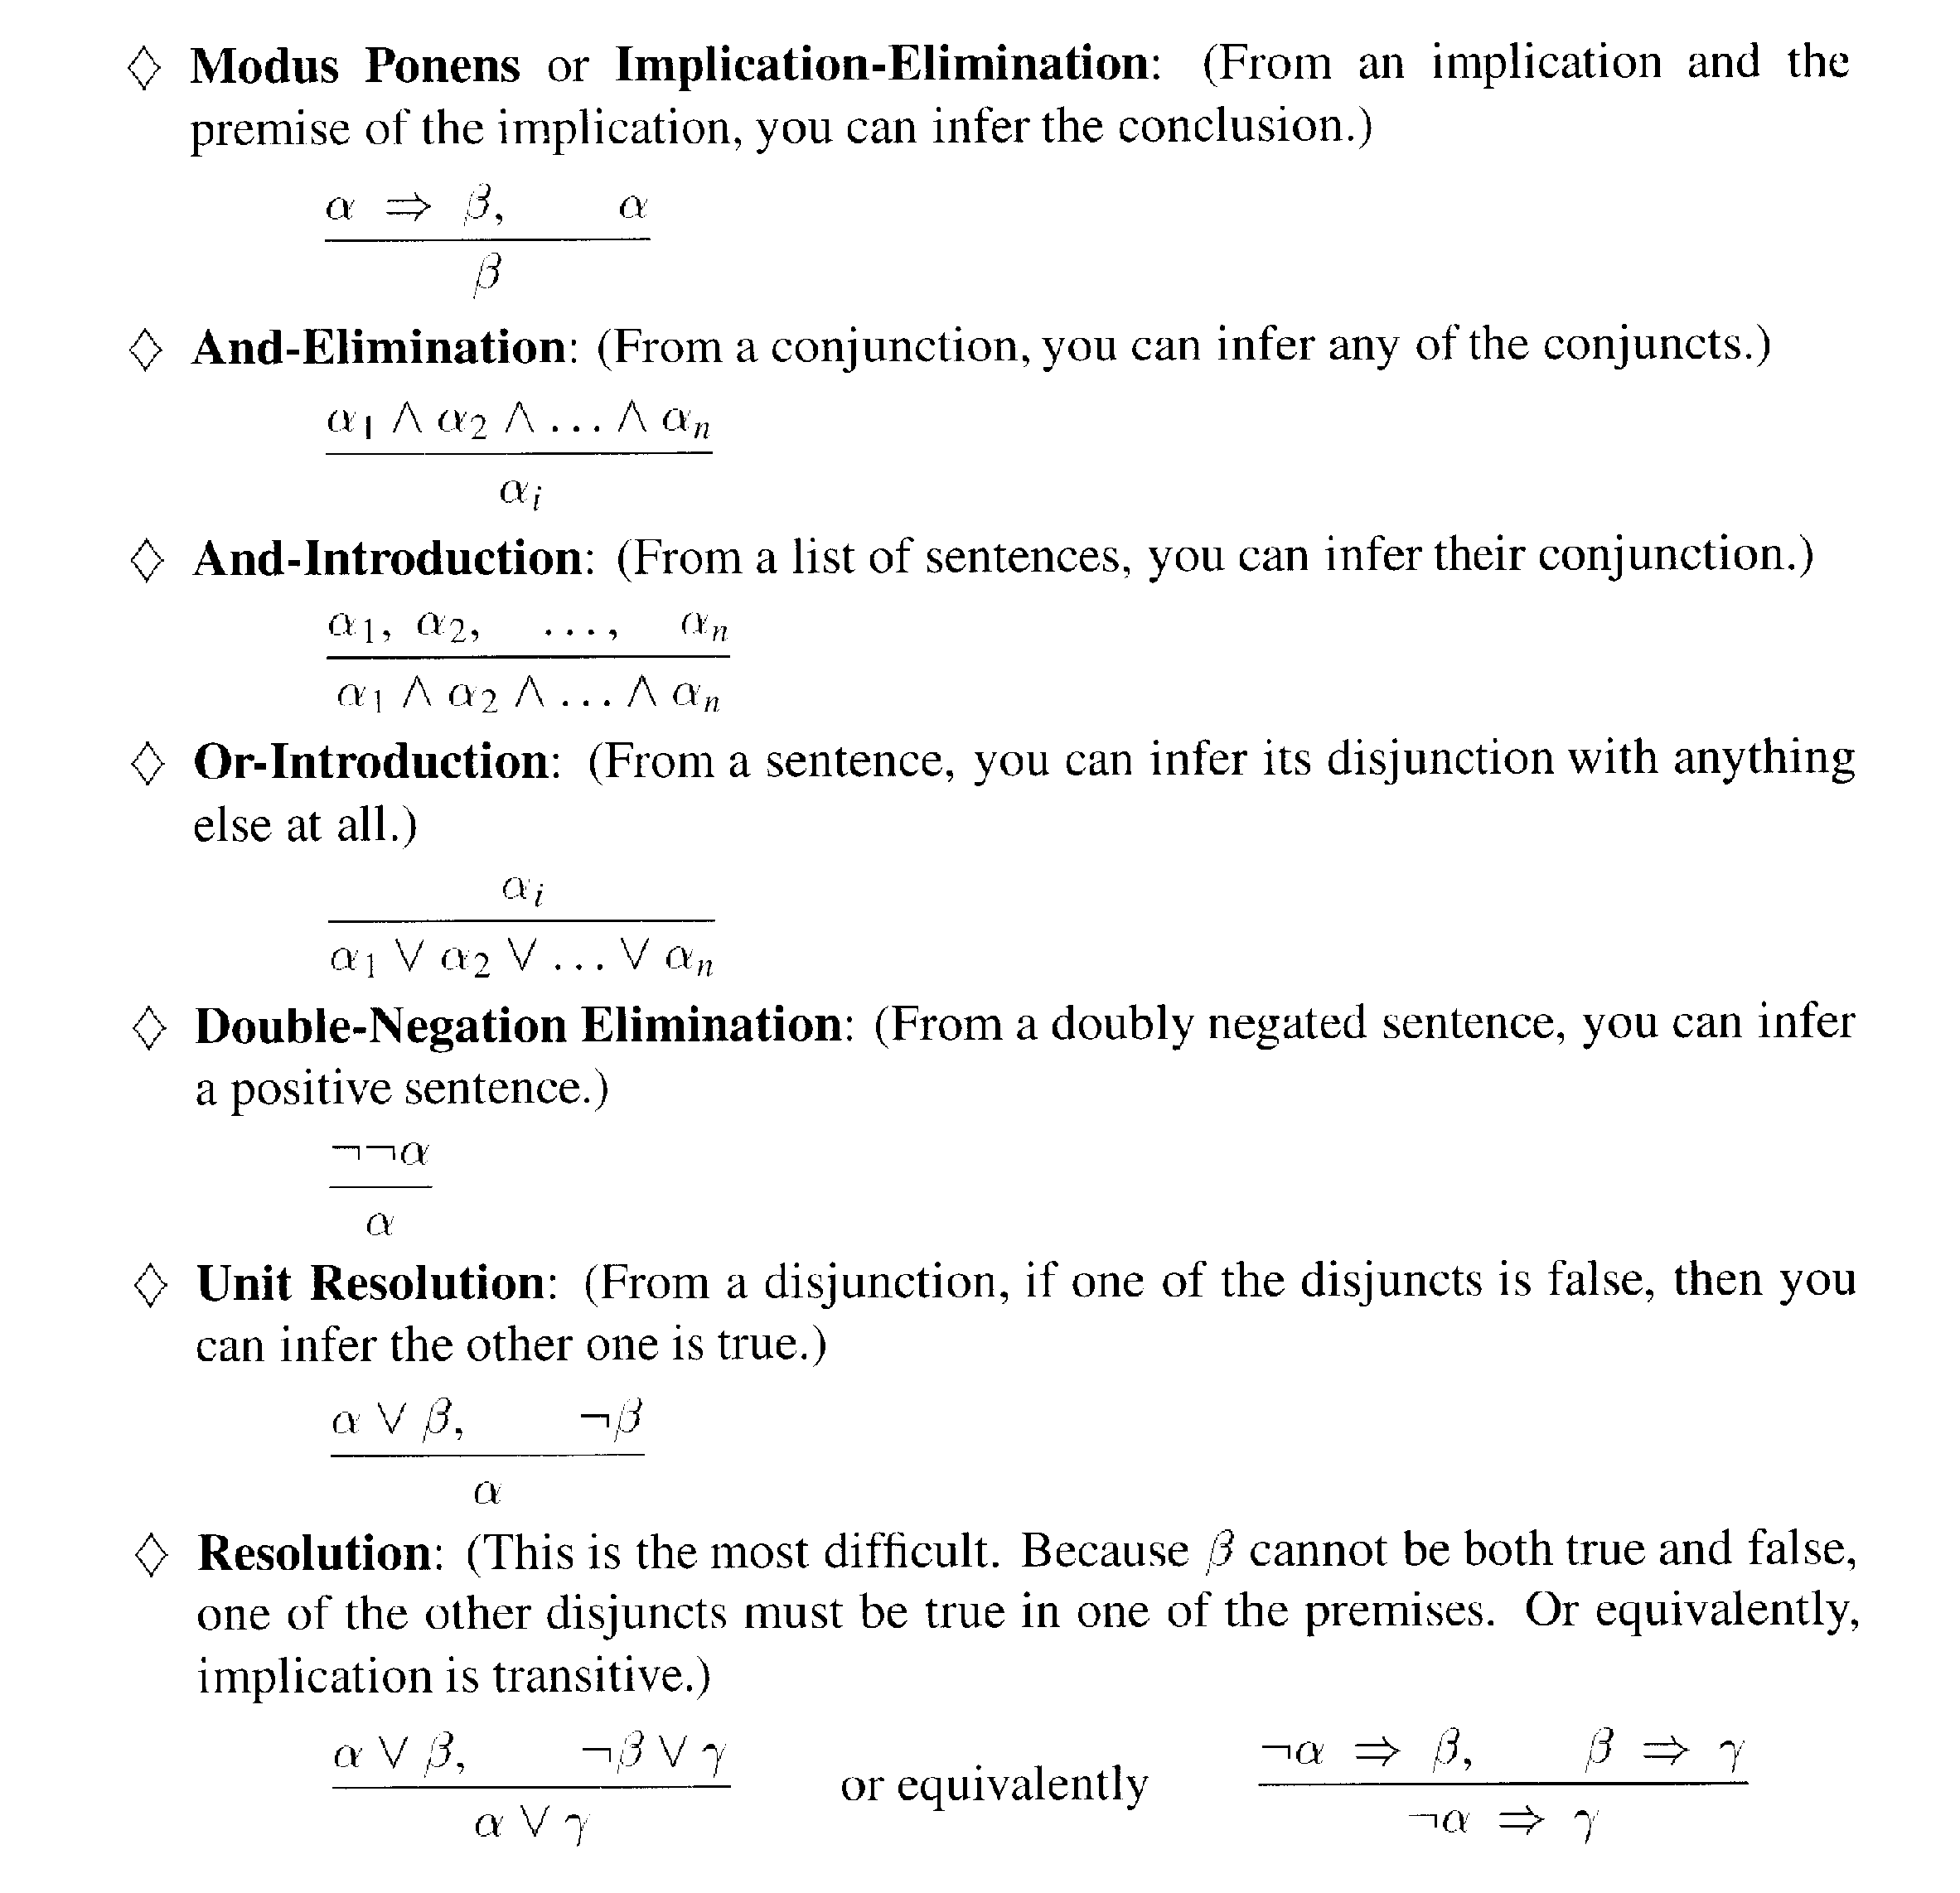
Last Time: Inference rules for propositional logic

Slide 5
This time
First-order logic
  Syntax
  Semantics
  Wumpus world example

Slide 6
Why first-order logic?
We saw that propositional logic is limited because it only makes the ontological commitment that the world consists of facts.
Difficult to represent even simple worlds like the Wumpus world;
e.g.,
“don’t go forward if the Wumpus is in front of you” takes 64 rules

Slide 7
First-order logic (FOL)
Ontological commitments:
  Objects: wheel, door, body, engine, seat, car, passenger, driver
  Relations: Inside(car, passenger), Beside(driver, passenger)
  Functions: ColorOf(car)
  Properties: Color(car), IsOpen(door), IsOn(engine)
Functions are relations with single value for each object

Slide 8
Examples:
“One plus two equals three”
Objects:
Relations:
Properties:
Functions:
“Squares neighboring the Wumpus are smelly”
Objects:
Relations:
Properties:
Functions:

Slide 9
Examples:
“One plus two equals three”
Objects: one, two, three, one plus two
Relations: equals
Properties: --
Functions: plus (“one plus two” is the name of the object obtained by applying function plus to one and two;
three is another name for this object)
“Squares neighboring the Wumpus are smelly”
Objects: Wumpus, square
Relations: neighboring
Properties: smelly
Functions: --

Slide 10
FOL: Syntax of basic elements
Constant symbols: 1, 5, A, B, USC, JPL, Alex, Manos, …
Predicate symbols: >, Friend, Student, Colleague, …
Function symbols: +, sqrt, SchoolOf, TeacherOf, ClassOf, …
Variables: x, y, z, next, first, last, …
Connectives: ∧, ∨, ⇒, ⇔
Quantifiers: ∀, ∃
Equality: =

Slide 11
FOL: Atomic sentences
AtomicSentence → Predicate(Term, …) | Term = Term
Term → Function(Term, …) | Constant | Variable
Examples: SchoolOf(Manos)
Colleague(TeacherOf(Alex), TeacherOf(Manos))
>((+ x y), x)

Slide 12
FOL: Complex sentences
Sentence → AtomicSentence
| Sentence Connective Sentence
| Quantifier Variable, … Sentence
| ¬ Sentence
| (Sentence)
Examples: S1 ∧ S2, S1 ∨ S2, (S1 ∧ S2) ∨ S3, S1 ⇒ S2, S1⇔ S3
Colleague(Paolo, Maja) ⇒ Colleague(Maja, Paolo)
Student(Alex, Paolo) ⇒ Teacher(Paolo, Alex)

Slide 13
Semantics of atomic sentences
Sentences in FOL are interpreted with respect to a model
Model contains objects and relations among them
Terms: refer to objects (e.g., Door, Alex, StudentOf(Paolo))
  Constant symbols: refer to objects
  Predicate symbols: refer to relations
  Function symbols: refer to functional Relations
An atomic sentence predicate(term₁, …, term_{n}) is true iff the relation referred to by predicate holds between the objects referred to by term₁, …, term_{n}

Slide 14
Example model
Objects: John, James, Marry, Alex, Dan, Joe, Anne, Rich
Relation: sets of tuples of objects
{<John, James>, <Marry, Alex>, <Marry, James>, …}
{<Dan, Joe>, <Anne, Marry>, <Marry, Joe>, …}
E.g.:
Parent relation -- {<John, James>, <Marry, Alex>, <Marry, James>}
then Parent(John, James) is true
Parent(John, Marry) is false

Slide 15
Quantifiers
Expressing sentences of collection of objects without enumeration
E.g., All Trojans are clever
Someone in the class is sleeping
Universal quantification (for all): ∀
Existential quantification (three exists): ∃

Slide 16
Universal quantification (for all): ∀
∀ <variables> <sentence>
“Every one in the 561a class is smart”:
∀ x In(561a, x) ⇒ Smart(x)
∀ P corresponds to the conjunction of instantiations of P
In(561a, Manos) ⇒ Smart(Manos) ∧
In(561a, Dan) ⇒ Smart(Dan) ∧
…
In(561a, Clinton) ⇒ Smart(Clinton)
⇒ is a natural connective to use with ∀
Common mistake: to use ∧ in conjunction with ∀
e.g: ∀ x In(561a, x) ∧ Smart(x)
means “every one is in 561a and everyone is smart”

Slide 17
Existential quantification (there exists): ∃
∃ <variables> <sentence>
“Someone in the 561a class is smart”:
∃ x In(561a, x) ∧ Smart(x)
∃ P corresponds to the disjunction of instantiations of P
In(561a, Manos) ∧ Smart(Manos) ∨
In(561a, Dan) ∧ Smart(Dan) ∨
…
In(561a, Clinton) ∧ Smart(Clinton)
∧ is a natural connective to use with ∃
Common mistake: to use ⇒ in conjunction with ∃
e.g: ∃ x In(561a, x) ⇒ Smart(x)
is true if there is anyone that is not in 561a!
(remember, false ⇒ true is valid).

Slide 18
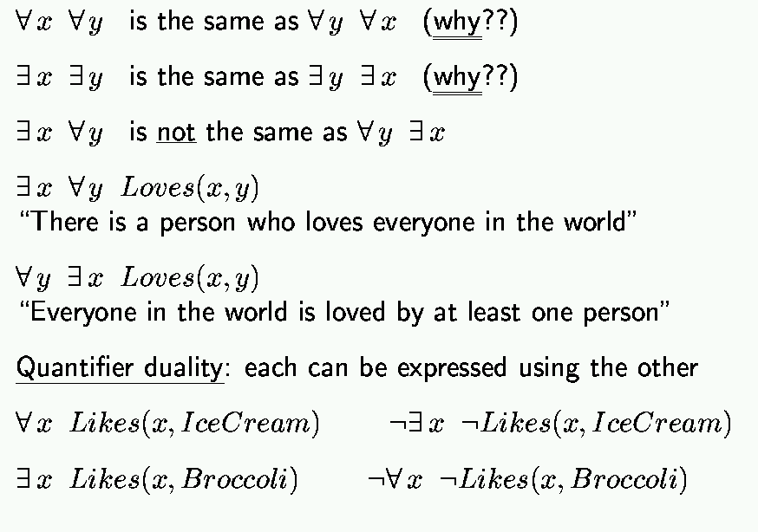
Properties of quantifiers

Slide 19
Example sentences
Brothers are siblings
Sibling is transitive
One’s mother is one’s sibling’s mother
A first cousin is a child of a parent’s sibling

Slide 20
Example sentences
Brothers are siblings
∀ x, y Brother(x, y) ⇒ Sibling(x, y)
Sibling is transitive
∀ x, y, z Sibling(x, y) ∧ Sibling(y, z) ⇒ Sibling(x, z)
One’s mother is one’s sibling’s mother
∀ m, c Mother(m, c) ∧ Sibling(c, d) ⇒ Mother(m, d)
A first cousin is a child of a parent’s sibling
∀ c, d FirstCousin(c, d) ⇔
∃ p, ps Parent(p, d) ∧ Sibling(p, ps) ∧ Parent(ps, c)

Slide 21
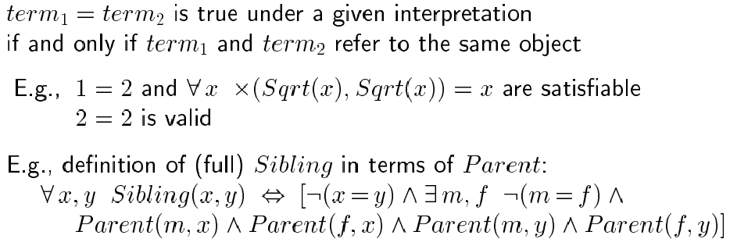
Equality

Slide 22
Higher-order logic?
First-order logic allows us to quantify over objects (= the first-order entities that exist in the world).
Higher-order logic also allows quantification over relations and functions.
e.g., “two objects are equal iff all properties applied to them are equivalent”:
∀ x,y (x=y) ⇔ (∀ p, p(x) ⇔ p(y))
Higher-order logics are more expressive than first-order; however, so far we have little understanding on how to effectively reason with sentences in higher-order logic.

Slide 23
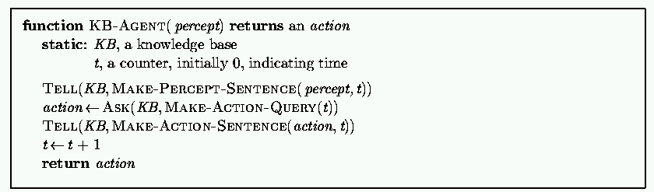
Logical agents for the Wumpus world
Remember: generic knowledge-based agent:
TELL KB what was perceived
Uses a KRL to insert new sentences, representations of facts, into KB
ASK KB what to do.
Uses logical reasoning to examine actions and select best.

Slide 24
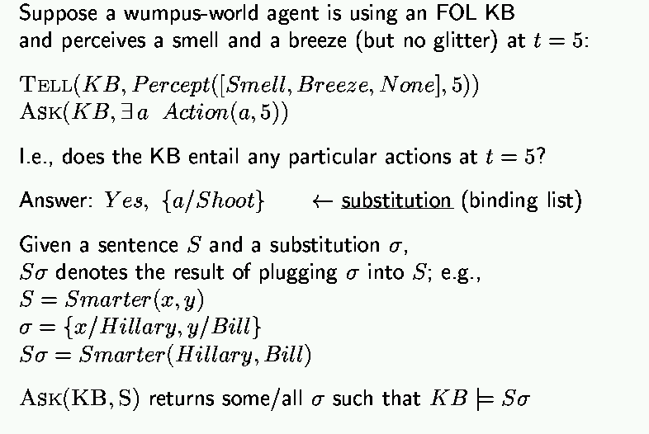
Using the FOL Knowledge Base

Slide 25
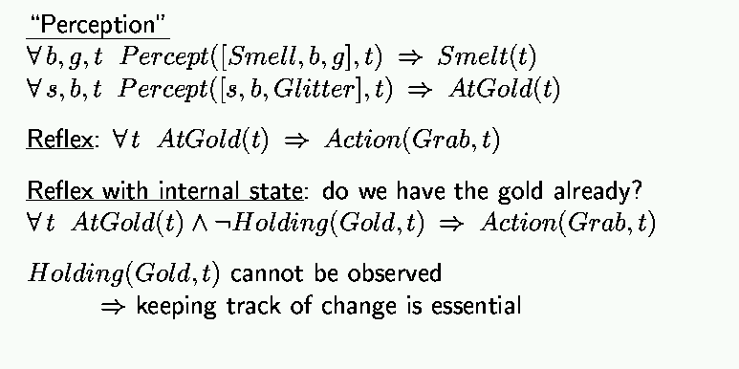
Wumpus world, FOL Knowledge Base

Slide 26
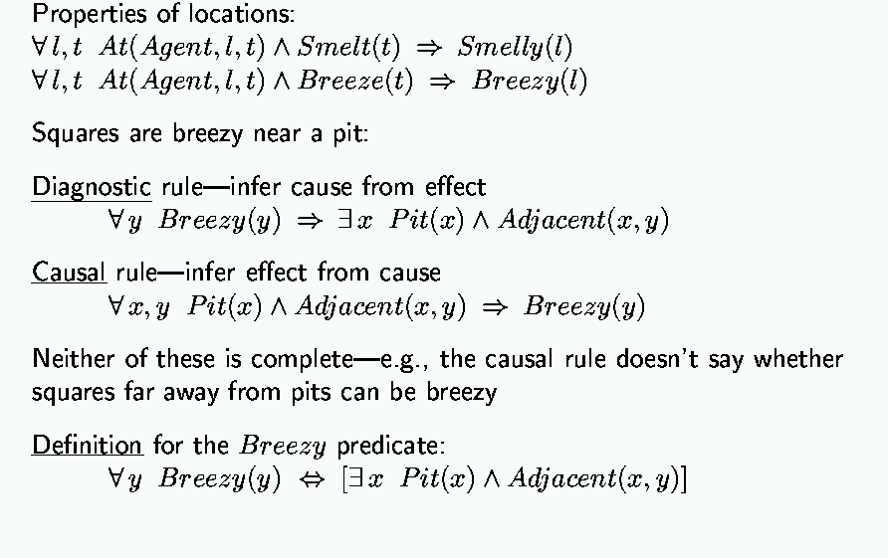
Deducing hidden properties

Slide 27
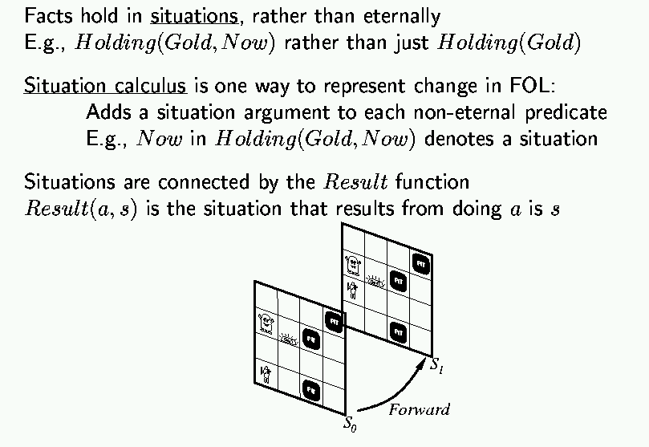
Situation calculus

Slide 28
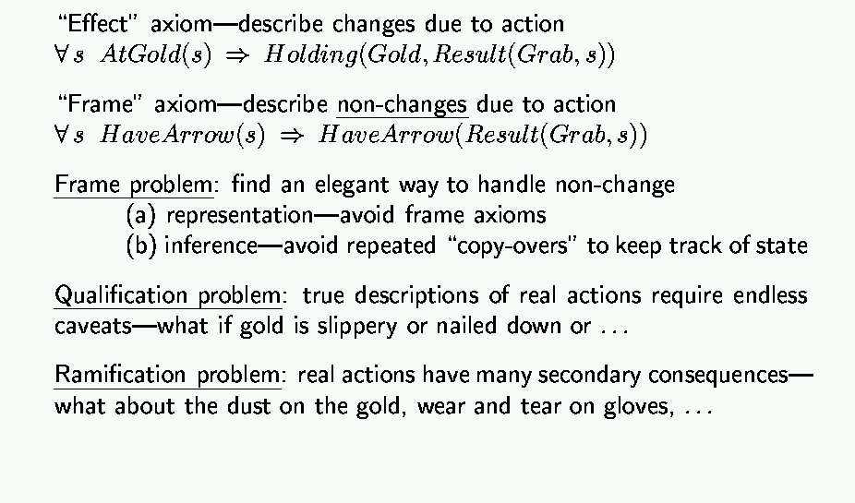
Describing actions

Slide 29
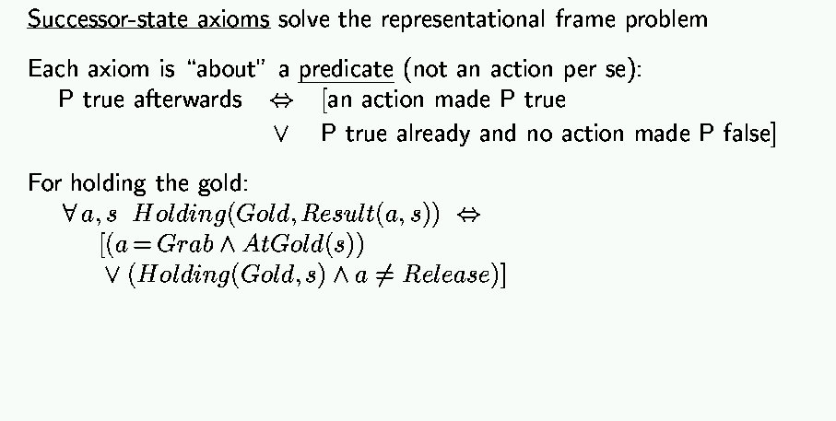
Describing actions (cont’d)

Slide 30
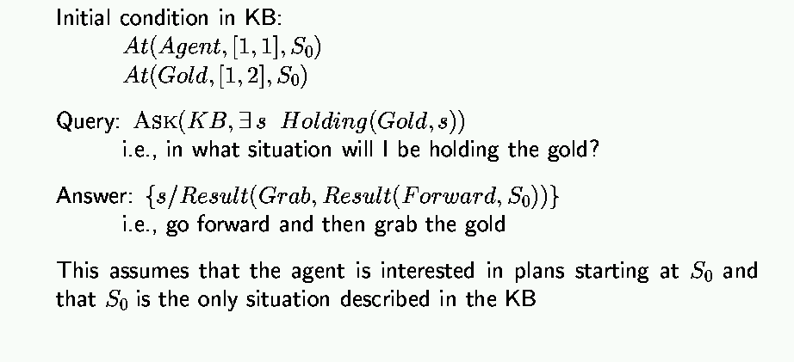
Planning

Slide 31
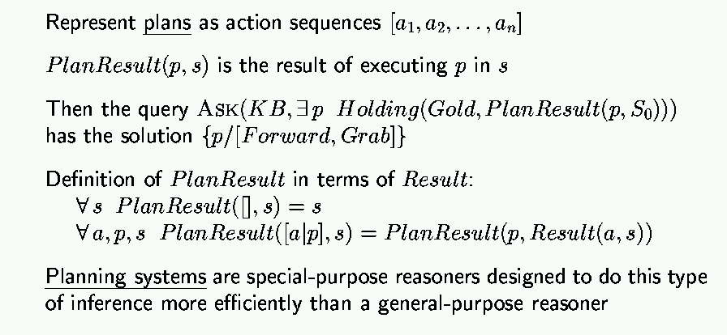
Generating action sequences

Slide 32
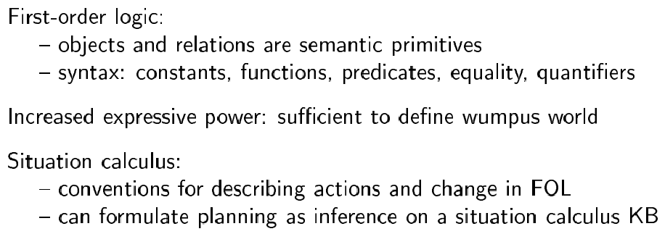
Summary

